Slide 1

HI6050 Capstone: Comprehensive Topic Selection and Supplementary Document
Supervisor: Dr. Farshid Keivanian
Session 3: Preparation for Group Research Proposal

Slide 2
Session 3’s outline
1. Weekly Task Breakdown & Milestones
2. Preparation for Group Research Proposal

Slide 3
Weekly Task Breakdown & Milestones
Week | Action
Week 1-2 | Form groups, confirm your campus group number, select topic via Blackboard sheet.
Week 3 | Begin literature review + define project scope and research question.
Week 4 | Finalize tools, datasets, programming language; create basic prototypes/mockups.
Week 5 | Draft your research proposal + submit it.
Week 6 | Submit Research Proposal (25%)
Week 7-10 | Start project build (coding/analysis), write sections of final report.
Week 11 | Submit Final Report (45%)
Week 12 | Present & Demo Project (30%)

Slide 4
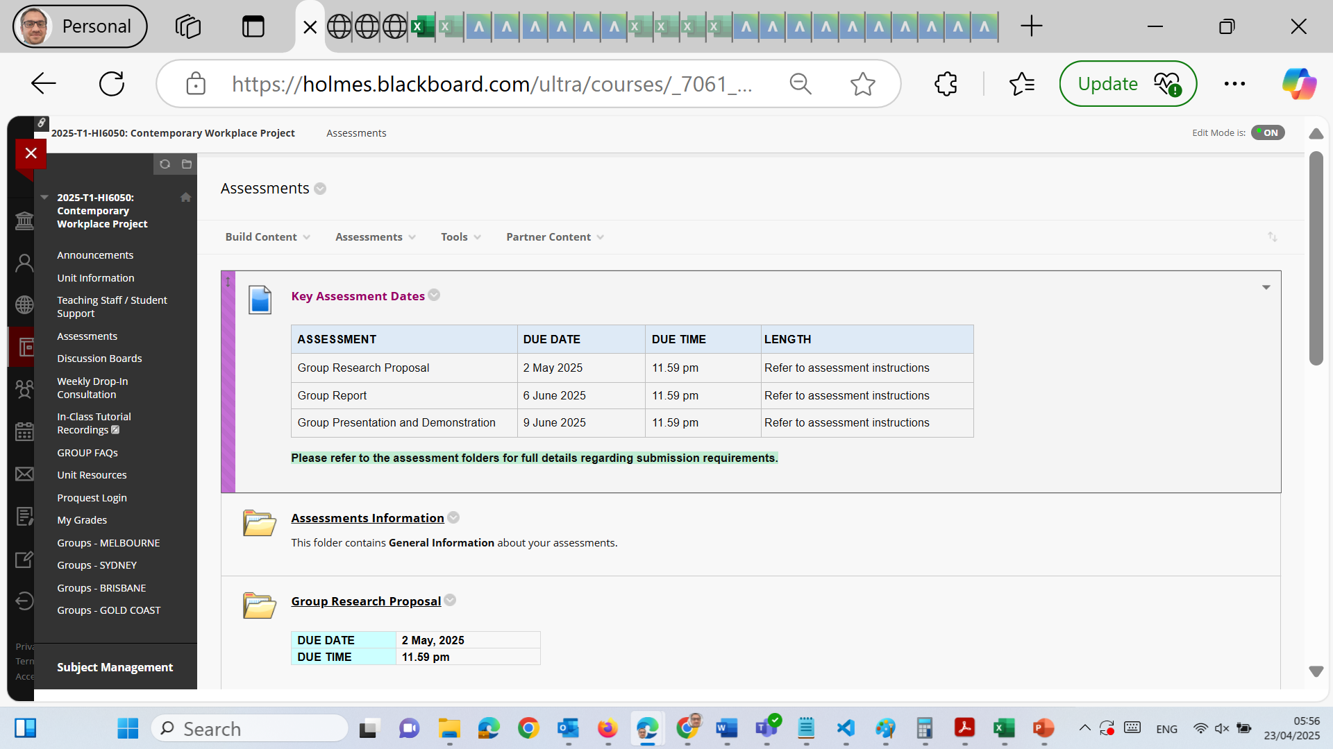
Preparation for Group Research Proposal

Slide 5
Preparation for Group Research Proposal

Slide 6
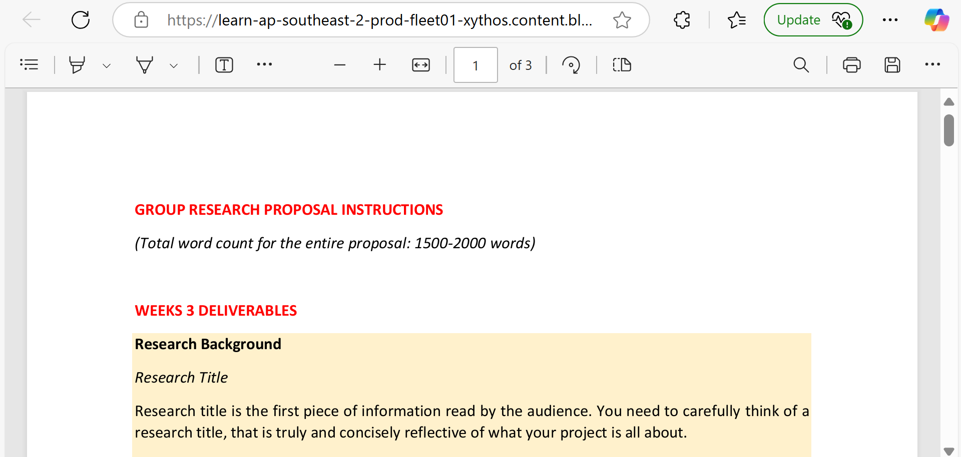
Preparation for Group Research Proposal

Slide 7
Preparation for Group Research Proposal
Submission Due: Week 6 Word Count: 1500–2000 words (group submission) Format: Microsoft Word (.docx) | Holmes Adaptive Harvard Referencing Submission Platform: Blackboard – From a desktop/laptop only Penalty: Students not listed on the cover sheet will not receive marks

Slide 8
Preparation for Group Research Proposal
Purpose of This Assignment
The Group Research Proposal helps define the research foundation of your capstone project. It sets the direction, focus, and rationale behind your future technical or applied research. This is not a final report but a strategic plan for a well-organized research journey.

Slide 9
Preparation for Group Research Proposal
WEEKLY DELIVERABLES CHECKLIST
Week 3 Deliverables
1. Research Title
Create a concise, clear, and reflective title of your project.
Avoid vague or overly broad topics.
Tip: Include keywords like “design,” “evaluation,” “development,” “impact,” or “framework.”

Slide 10
Preparation for Group Research Proposal
2. Abstract (Write Last!)
A single paragraph summarizing:
Background and context of your topic
Research problem
Methodology (literature review)
Expected or preliminary insights

Slide 11
Preparation for Group Research Proposal
3. Introduction
Introduce the broad area of research.
Discuss:
What is the topic about?
Why is it important?
What will your group do?

Slide 12
Preparation for Group Research Proposal
4. Problem Background
Provide context with references to justify the relevance of the problem.
Use peer-reviewed sources, government publications, and industry reports.

Slide 13
Preparation for Group Research Proposal
5. Problem Statement
A single precise sentence summarizing the core problem.
Example: “Despite widespread use, digital identity systems remain inaccessible to remote populations, limiting financial inclusion.”

Slide 14
Preparation for Group Research Proposal
Week 4 Deliverables
6. Research Objectives
Clearly state what your group wants to achieve.
Use bullet points for clarity.

Slide 15
Preparation for Group Research Proposal
7. Research Question
Formulate one main question.
Should be specific, focused, and answerable through literature review.

Slide 16
Preparation for Group Research Proposal
8. Project Scope
Explain what is included and excluded.
Justify the boundaries to keep the project focused and achievable.

Slide 17
Preparation for Group Research Proposal
9. Research Methods
Use qualitative method: Literature Review.
Describe:
Why literature review is suitable
What types of sources will be reviewed
Why other methods (e.g., surveys, experiments) are not used

Slide 18
Preparation for Group Research Proposal
Week 5 Deliverables
10. Preliminary Results
Based on your early reading, what patterns, themes, or gaps have you observed?

Slide 19
Preparation for Group Research Proposal
11. Project Timeline
Include a Gantt Chart.
Use weekly milestones (e.g., proposal submission, review analysis, final paper drafting, presentation).

Slide 20
Preparation for Group Research Proposal
12. Conclusion
Revisit:
Problem significance
Your main objective
Planned methodology
Next steps after proposal approval

Slide 21
Preparation for Group Research Proposal
13. References
Use Holmes’s Adapted Harvard Style.
Ensure all cited works are included.
Minimum of 8–10 scholarly sources recommended.

Slide 22
Preparation for Group Research Proposal
What to Avoid
❌ Submitting in PDF or other formats (must be .docx) ❌ Using AI-generated content without editing or citations ❌ Copy-pasting chunks from online sources (risk of plagiarism) ❌ Submitting from phones or tablets (desktop/laptop only) ❌ Forgetting to include all group members on the cover sheet

Slide 23
Preparation for Group Research Proposal
Tips for Success
Use Google Scholar, ProQuest, IEEE Xplore for quality sources.
Stay within word count but ensure completeness.
Schedule internal deadlines for each section by week.
Use clear section headings, e.g., “Problem Background,” “Research Objectives.”
Assign roles (writer, editor, reference checker, Gantt chart designer).
Discuss challenges during weekly team meetings.

Slide 24
Preparation for Group Research Proposal
Final Checklist Before Submission
Is your cover sheet complete with all group members?
Is the file a Microsoft Word document (.docx)?
Have all references been properly cited using Harvard Style?
Is your research question clearly stated and relevant?
Did you include a Gantt Chart or timeline?
Is your work original, cited, and well-structured?

Slide 25
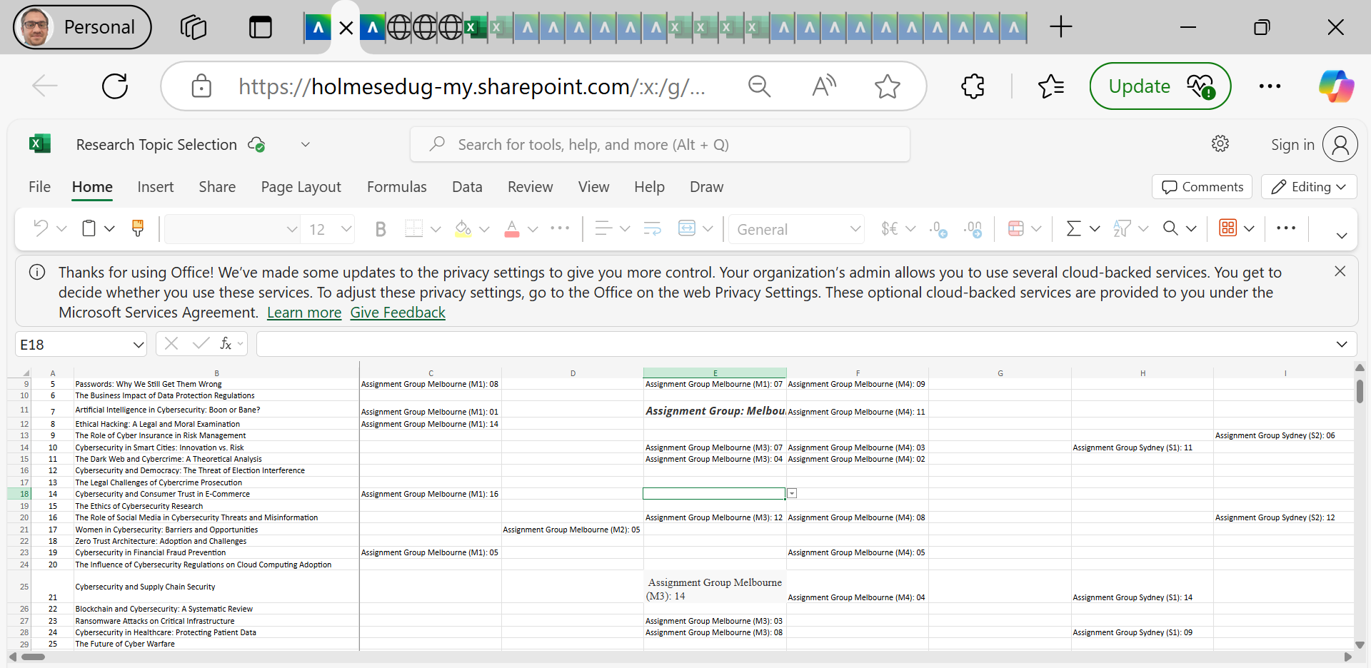
Preparation for Group Research Proposal

Slide 26
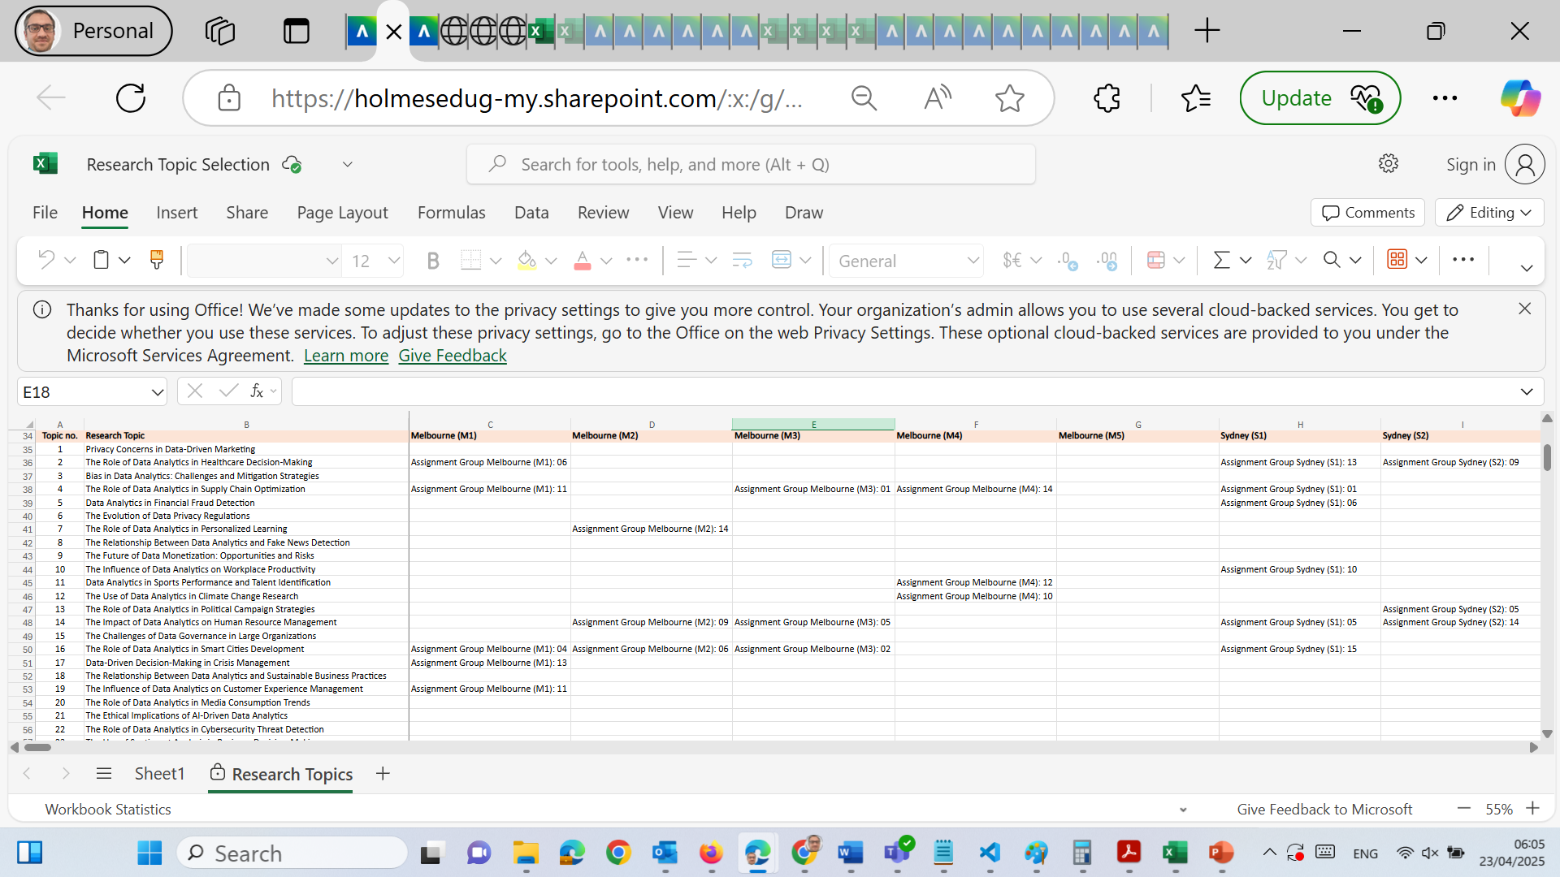
Preparation for Group Research Proposal

Slide 27
Preparation for Group Research Proposal
For Cybersecurity-Focused Topics
Example Topics:
The Ethics of Cybersecurity Research
Cybersecurity in Smart Cities: Innovation vs. Risk
Zero Trust Architecture: Adoption and Challenges
Recommended Keywords for Research Title: “Risks,” “Framework,” “Trust,” “Threat Modelling,” “Policy,” “Innovation,” “Ethics”

Slide 28
Preparation for Group Research Proposal
Problem Background Sample:
“As urban digital infrastructure evolves into smart cities, new threat vectors emerge due to interconnected devices. Cybersecurity risks have grown, yet research on balancing innovation with protection remains underdeveloped.”
Research Question Sample:
“How can Zero Trust Architecture be effectively implemented in smart cities without compromising innovation?”

Slide 29
Preparation for Group Research Proposal
Method Guidance:
Focus on literature review of frameworks like Zero Trust, NIST, ISO 27001, etc.
Use sources from ACM Digital Library, IEEE Xplore, and government cybersecurity strategies (Australia, UK, US).

Slide 30
Preparation for Group Research Proposal
For Data Analytics-Focused Topics
Example Topics:
The Role of Data Analytics in Supply Chain Optimization
Data Analytics for Customer Experience Management
The Relationship Between Fake News Detection and Data Analytics

Slide 31
Preparation for Group Research Proposal
Recommended Keywords for Research Title: “Predictive Modeling,” “Customer Insights,” “Real-time Analysis,” “Sentiment Detection,” “Optimization”
Problem Background Sample:
“Misinformation spread during elections and crises has grown with the rise of social media. While detection methods exist, real-time analytical models for flagging and classifying fake news remain underdeveloped in non-English contexts.”

Slide 32
Preparation for Group Research Proposal
Research Question Sample:
“How can machine learning and data analytics be applied to improve the accuracy of fake news detection across diverse media platforms?”
Method Guidance:
Focus on academic reviews of sentiment analysis, natural language processing (NLP), and data labeling methods.
Use Google Scholar, Scopus, and data science case studies from Springer, Elsevier, or arXiv.

Slide 33
Preparation for Group Research Proposal
Research Method Tips (Literature Review Focus)
Regardless of your topic:
Element | Good Example | What to Avoid
Search Database | IEEE Xplore, ProQuest, Google Scholar | Wikipedia, blogs
Source Type | Peer-reviewed articles, conference proceedings | Social media posts
Citation Count | Use high-impact, widely cited sources | Obscure, uncited publications
Comparative Analysis | Compare findings of 3–4 authors on same issue | One-sided claims

Slide 34
Preparation for Group Research Proposal
Topic-Specific Tips: What to Include
Topic Area | Tip
Cybersecurity Ethics | Use case studies on ethical hacking, surveillance, and GDPR
Data in Healthcare | Reference privacy laws like HIPAA or Australia’s My Health Record policy
Fake News Detection | Mention NLP libraries, datasets (LIAR, FakeNewsNet), algorithm comparisons
Data-Driven HR or Marketing | Integrate CRM platforms, employee sentiment analysis, Power BI usage
Supply Chain Optimization | Include visual dashboards, logistics flow diagrams, and forecasting models

Slide 35
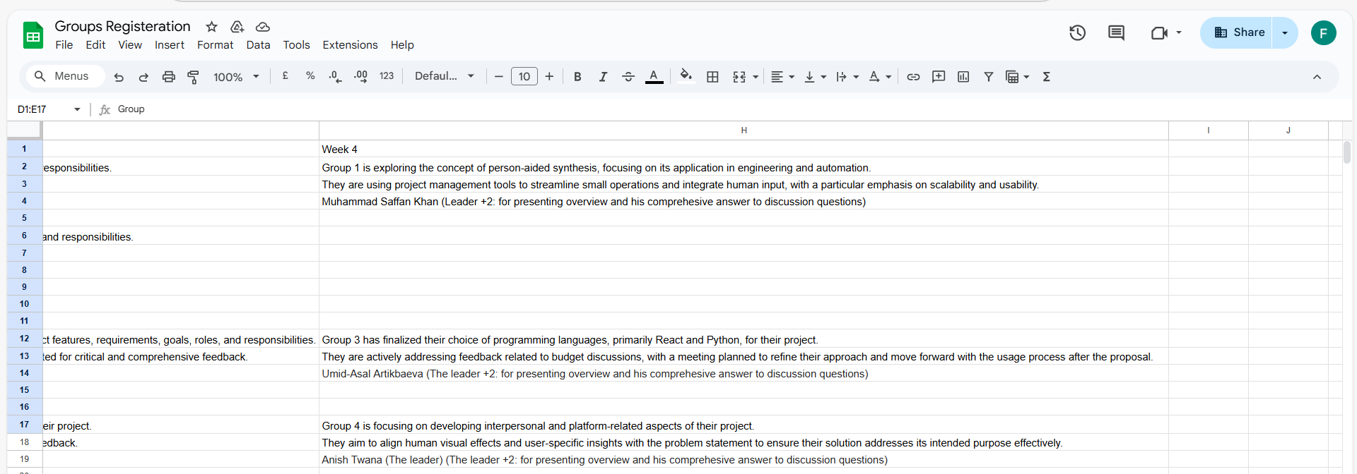
Group Progress Presentation – Overview of Progress at least 2 min

Slide 36
Thank You
Need Help? Send an email or ask during the tutorial session.
Good luck with your capstone journey!
Dr. Farshid Keivanian Capstone Project Supervisor farshid.keivanian@holmes.edu.au

